Slide 1
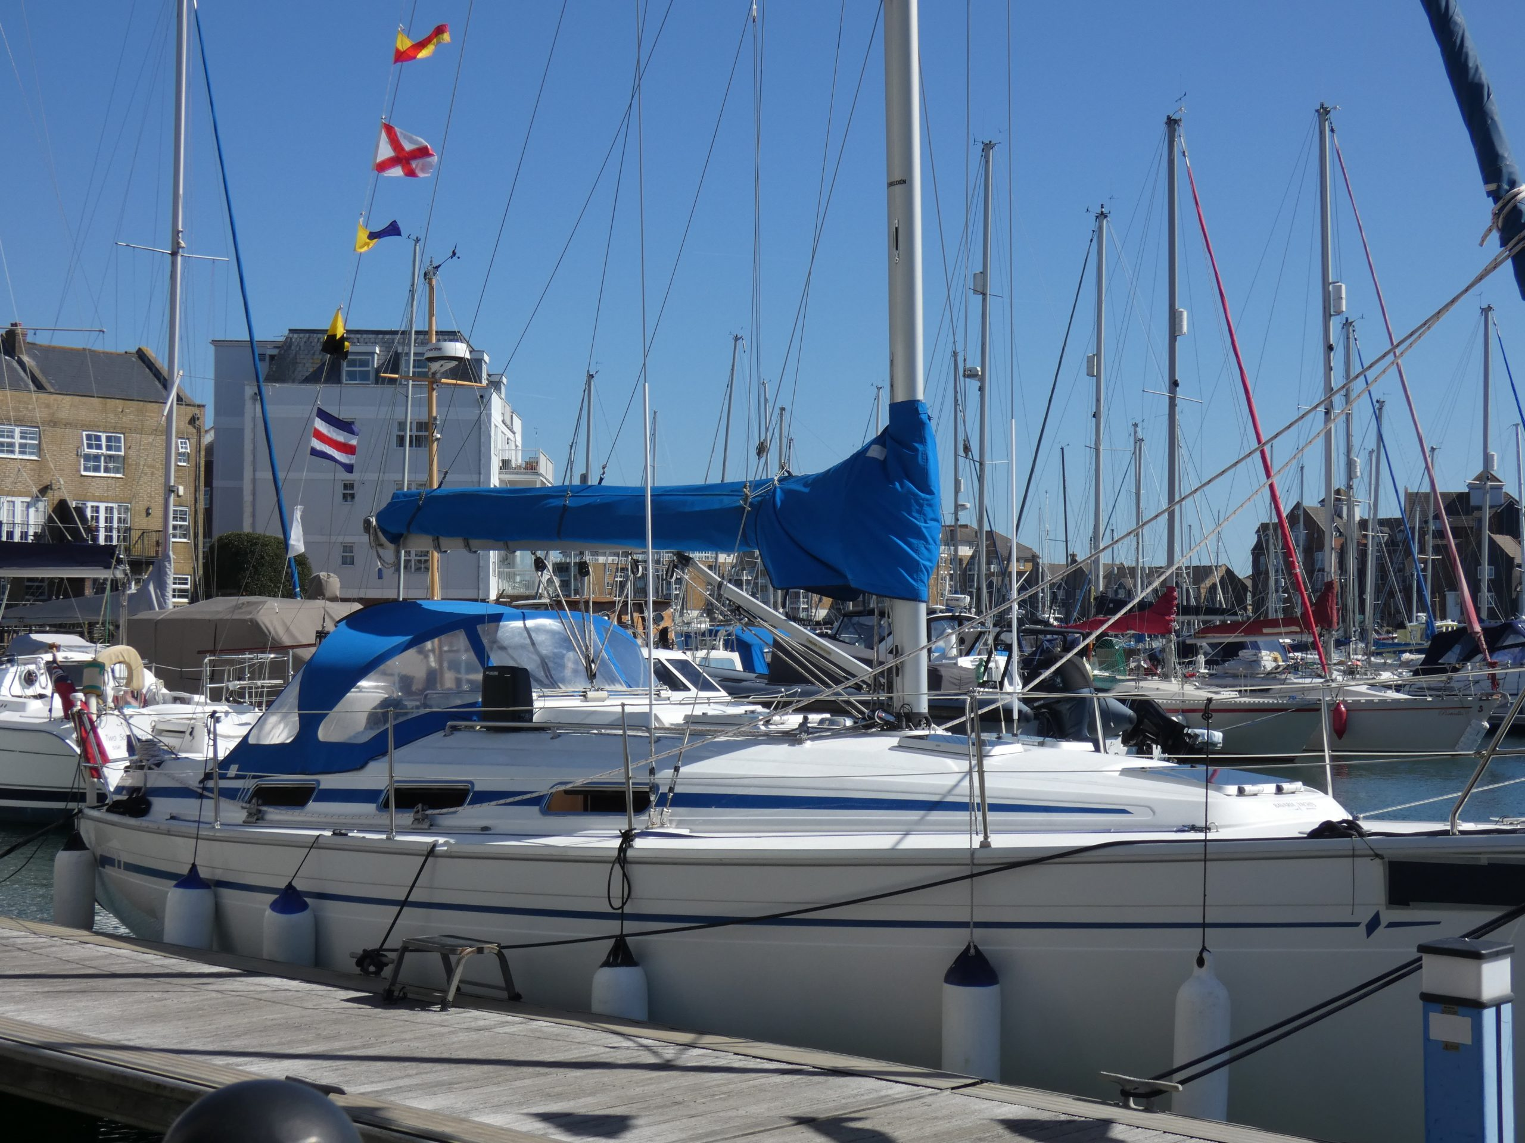
Man Overboard
Ray Collins
Ray Collins
14th March 2026

Slide 2
Ask the audience
How many present:
  are yacht owners?
  have been on Jebbs
  have sailed more than once?
  have been overboard and into the water?
  are unfamiliar with the terms:
    Cockpit
    Boom
    Mainsheet
    Jackstay
    Freeboard

Slide 3
Topics
Why Man Overboard? – MOB, safety, internationally recognised distress call, all radios have that designated setting, all stations recognise the term
Minimising a MOB situation
Implications of a MOB occurrence
Stages of a MOB recovery
MOB survival skills
Practical tasks and demos

Slide 4
Minimising a MOB situation:
  Safety Briefing – mandatory
  Lifejackets – on deck – wear one
  Lifejackets - are not all the same, but there are key ‘must-haves’ if one goes out in adverse conditions
  One hand for the boat, one hand for yourself (3 points of contact) – just as in climbing
  Jack stays and safety lines – different types and how to use one
  Stay low and on the high side - avoid the boom
  Stay in the cockpit – it is the safest place
  Practical tasks – fitting and wearing a life jacket, attaching a safety line

Slide 5
Implications of a MOB occurrence:
  Drowning – unlikely if one is wearing the correct kit
  Cold water shock - how to avoid – fitness is no guarantee
  Secondary drowning - 48 hours window
  Hypothermia – techniques to extend the survival time (10-15 minutes)
  Injuries - the usual range of shore-side injuries
  Mandatory Mayday - casualty return to shore
  A Board of Inquiry - especially if injury or death

Slide 6
Stages of a MOB recovery:
  Visually locating and pointing at the MOB – the more pointers the better
  Radio - Mayday procedure – the writing’s on the wall
  The 'toys' - danbuoy, light, horseshoe, throwing line, fenders, boat hook, flares
  Prepping the boat for recovery – effectively, non-essential crew to go below
  Moving alongside the casualty – the yacht will perform manoeuvres, some of which will not make sense to the inexperienced
  Bringing the casualty onboard – this will require deploying specialist kit – block & tackle, winches
  Treating the casualty – standard first aid procedures, except space will be at a premium
  In the case of multiple casualties in the water, we might deploy the life raft

Slide 7
MOB survival skills:
  Don't panic or struggle - keep calm
  Conserve energy
  Don't try swimming unless...
  ...the Danbuoy, horseshoe or other floatation devices are close.....in which case….
  ......swim on your back – your lifejacket will force you to do this
  Use the life jacket whistle, rather than shouting
  Wait for the boat to come back for you - it will, honestly...
  If you are on the yacht, do not jump in to help – you have just become a casualty!

Slide 8
Practical tasks:
Throwing line demo
Simulated block and tackle recovery demo
Boathook exercise - a la duck at the fairground
Tying a bowline - around the waist & through a loop
Lifejacket exercise including bowline tying through its recovery ring
Walk along the jackstay wearing a lifejacket and safety

Slide 9
Questions and Answer session
Is a MOB situation likely? – on Jebbs NO!, as the permitted weather conditions and activities asked of the crew minimise the probability.
I want to go sailing in all weathers, what qualities should a life jacket have? – correct for your weight, hood, light, whistle, auto-inflation, manual inflation, rescue loop, dual leg straps.
How else can I protect myself in all weathers? – MOB Lifesaver, Personal Locator Beacon (PLB), cutaway knife

Slide 10
Join us on Jebbs https://shyc.co.uk/shyc-club-boat-yacht/

Slide 11
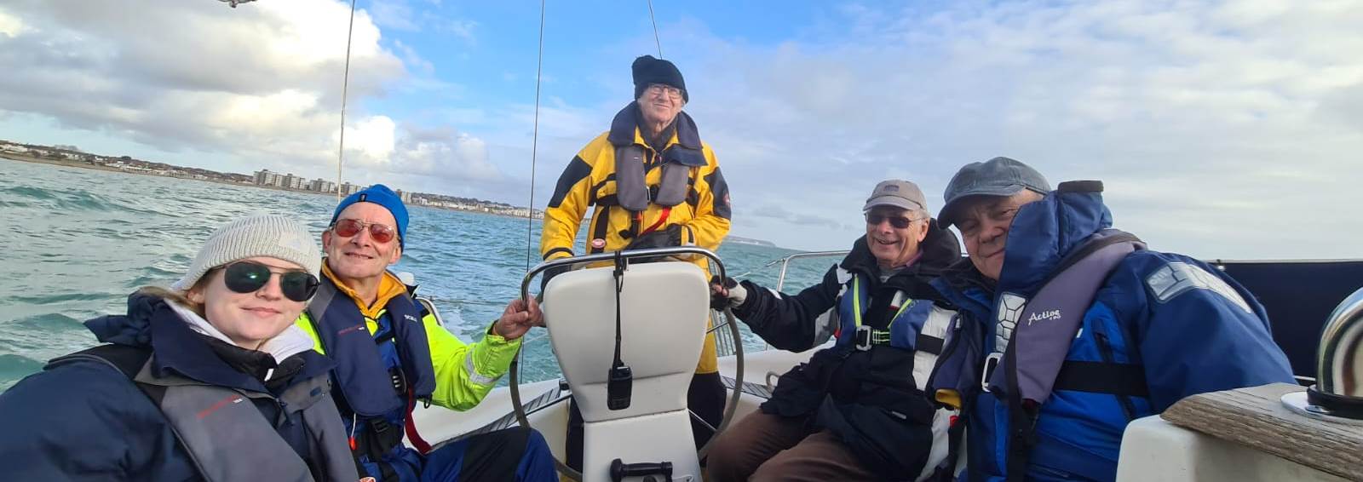
Cockpit

Slide 12
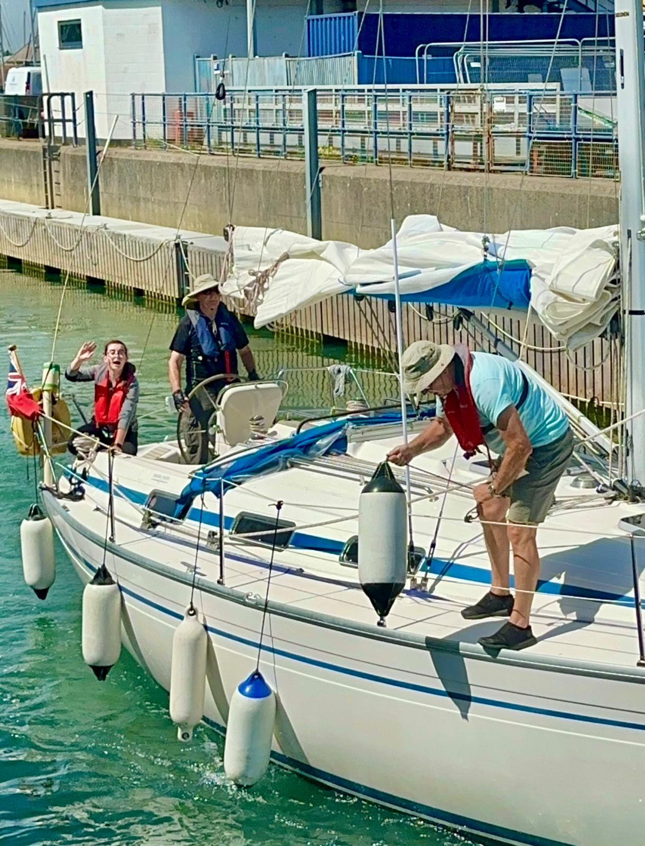
Boom

Slide 13
Mainsheet

Slide 14
Freeboard

Slide 15
Jackstay

Slide 16
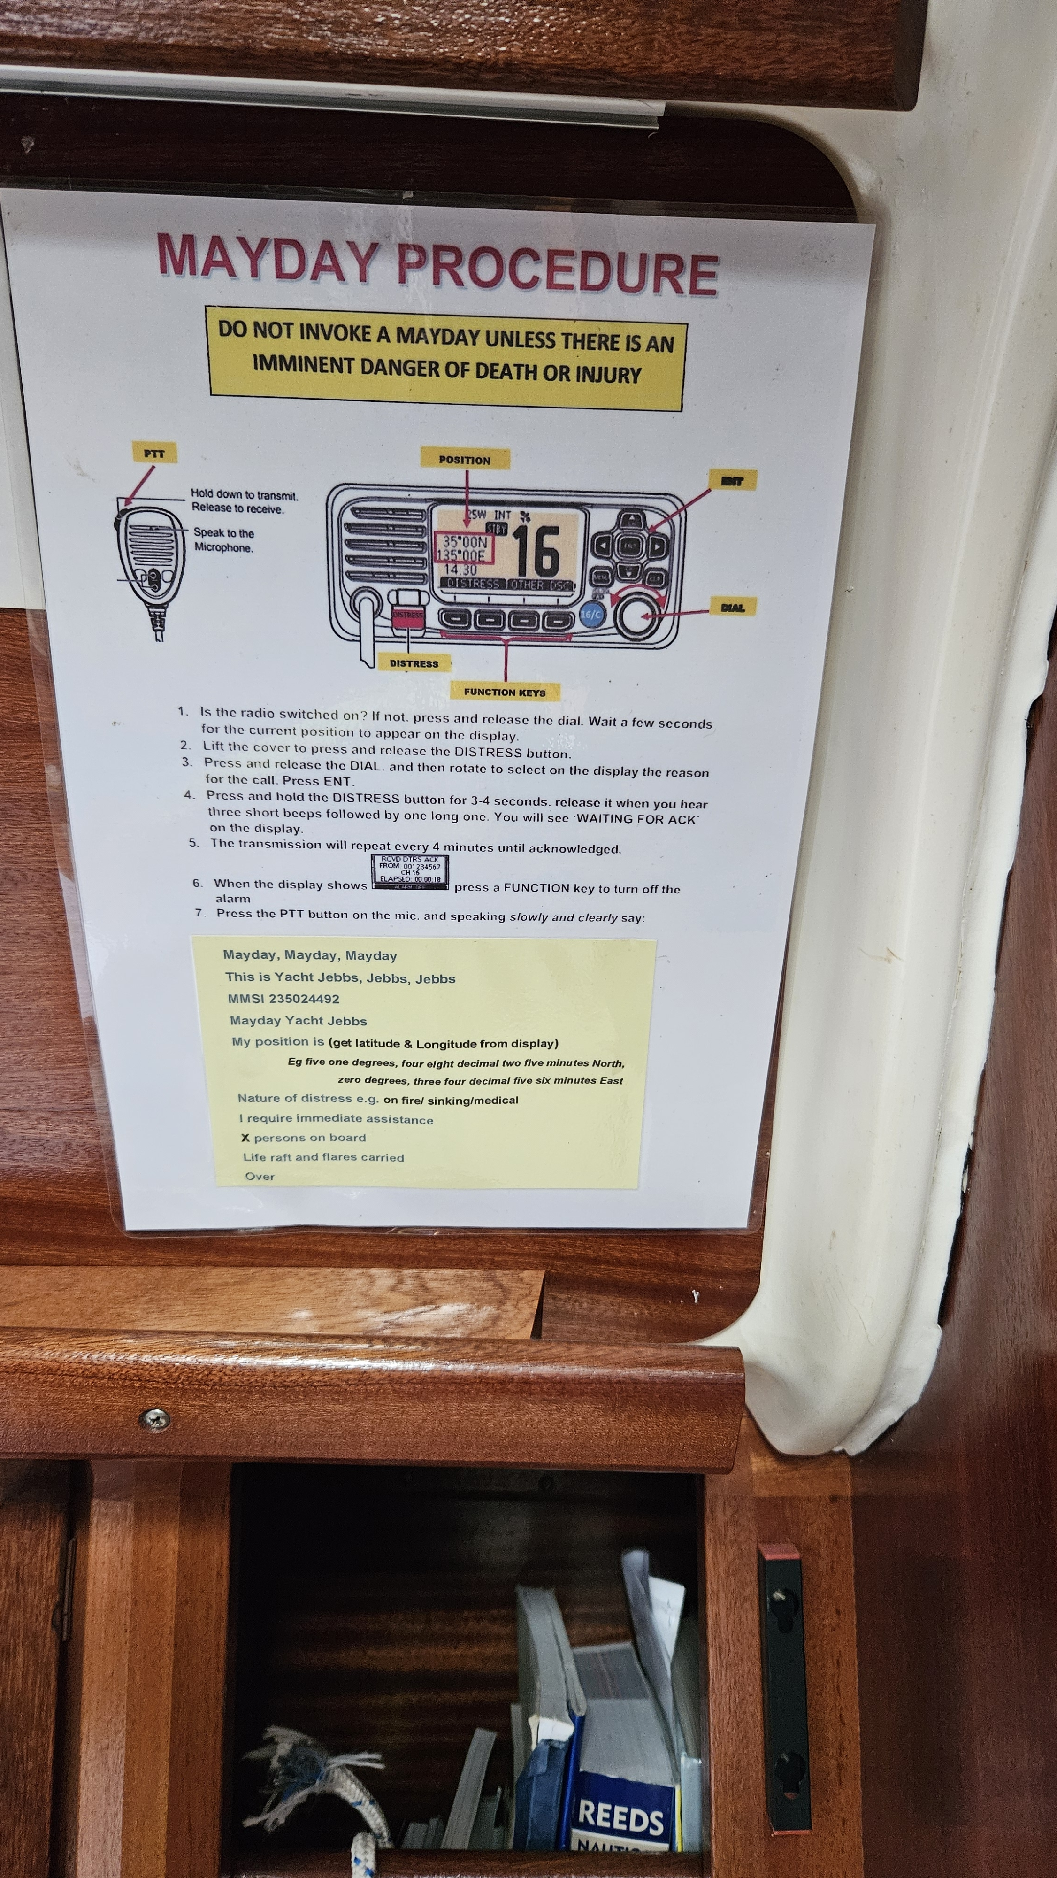
The writing’s on the wall

Slide 17
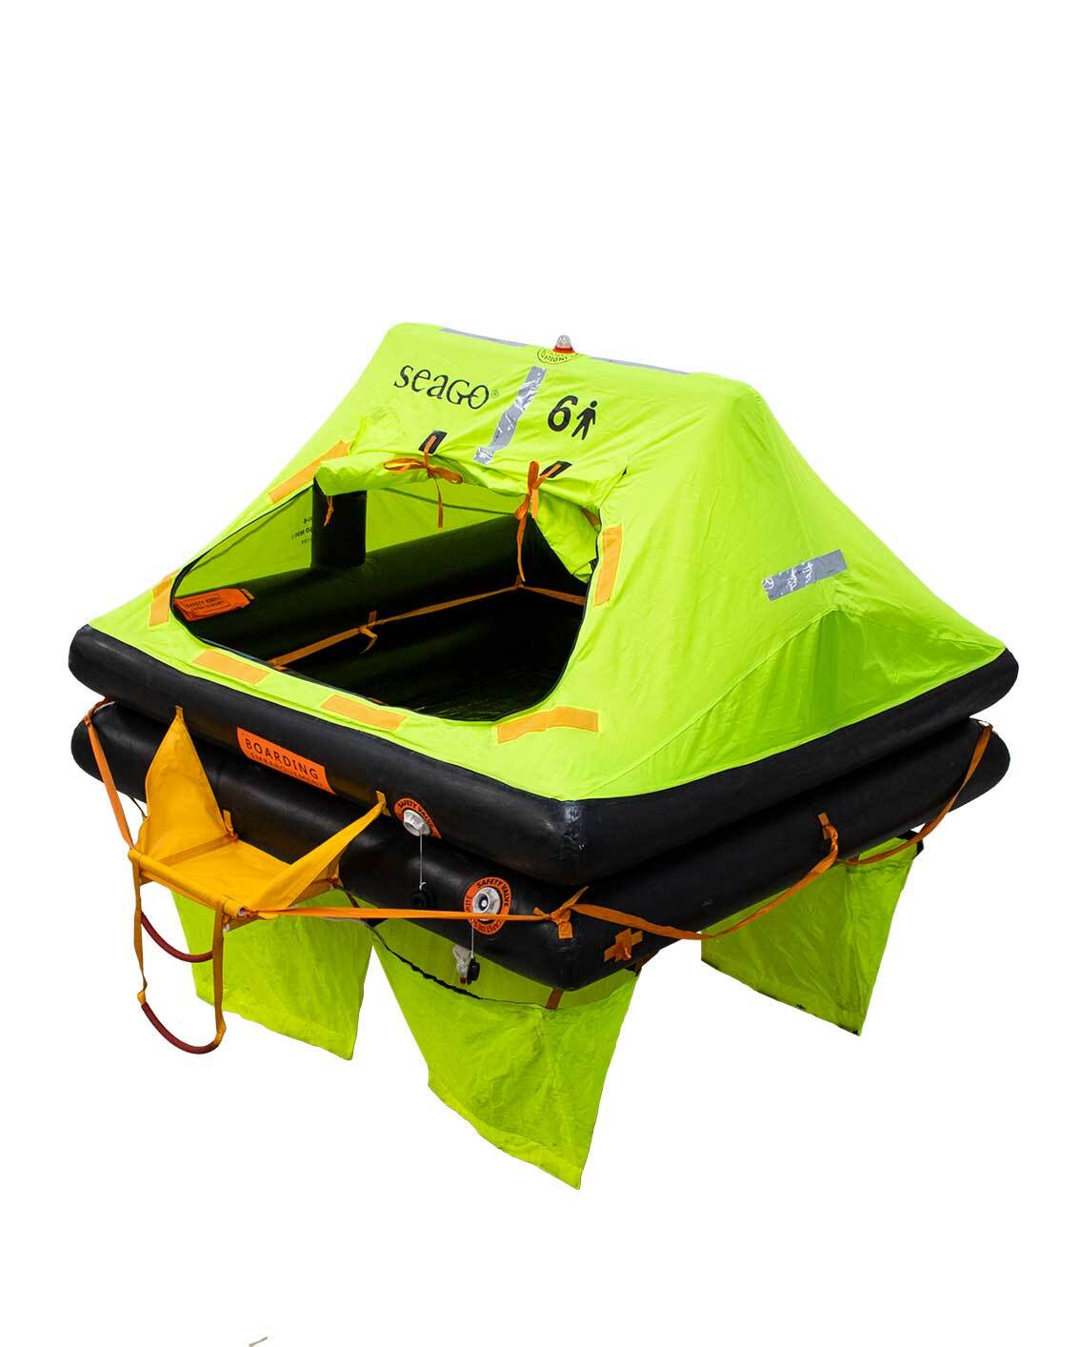
Life Raft
Copyright Seago

